Slide 1
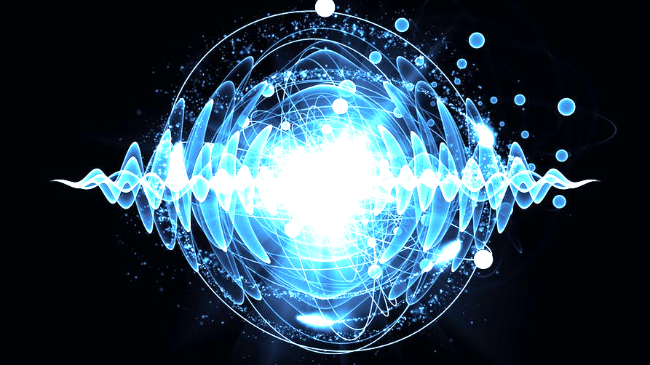

Quantum Computing Project
H
Agnibho Chattarji ● Fidel Elie ● Ewan Morrison ● Alasdair Reid ● Jake Smith

Slide 2
Introduction to Quantum Computing
Agnibho Chattarji ● Fidel Elie ● Ewan Morrison ● Alasdair Reid ● Jake Smith

Slide 3
Motivation
The progress of Computational power over the last 50 years has been possible through reducing the size of transistors
Why can't this continue?
Agnibho Chattarji ● Fidel Elie ● Ewan Morrison ● Alasdair Reid ● Jake Smith

Slide 4
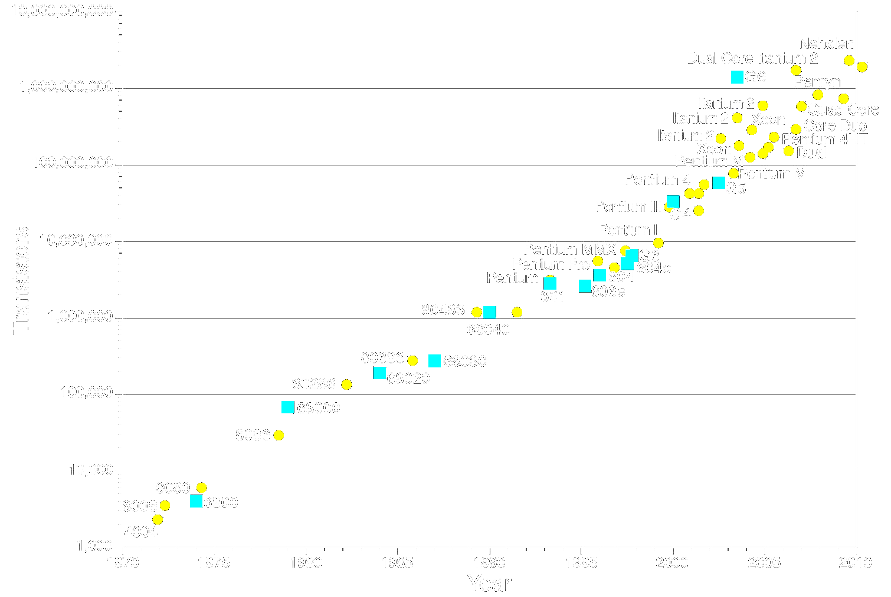
Agnibho Chattarji ● Fidel Elie ● Ewan Morrison ● Alasdair Reid ● Jake Smith

Slide 5
Classical Computing
Classical computing is based in implementing two key features; storing numbers in memory and using mathematical operators to process those numbers
Both storage and processing are achieved through using transistors
Computers perform calculations using logic gates.
Agnibho Chattarji ● Fidel Elie ● Ewan Morrison ● Alasdair Reid ● Jake Smith

Slide 6
Basics of Quantum Computing
Among the first to examine the issue were the IBM research physicists Rolf Landauer and Charles Bennett.
In 1982 Richard Feynman sketched out a design for how a machine using principles based in quantum mechanics could carry out basic computations
A quantum computer would be built using quantum bits known as qubits
Agnibho Chattarji ● Fidel Elie ● Ewan Morrison ● Alasdair Reid ● Jake Smith

Slide 7
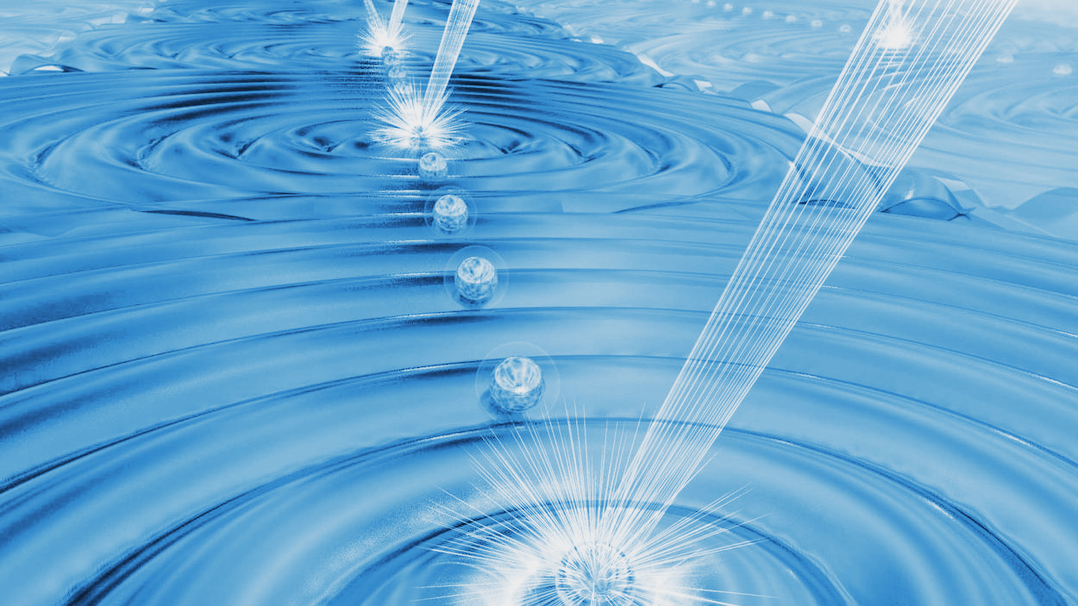
Physics Implementation of Quantum Computers
53 qubit quantum simulator at the University of Maryland using ions of ytterbium
Agnibho Chattarji ● Fidel Elie ● Ewan Morrison ● Alasdair Reid ● Jake Smith

Slide 8
Are Quantum Computers Better?
There are some very well known benefits to quantum computing such as Grover’s algorithm and Shor’s algorithm
Unfortunately there are currently a very small number of quantum algorithms known
Agnibho Chattarji ● Fidel Elie ● Ewan Morrison ● Alasdair Reid ● Jake Smith

Slide 9
The Basics of Quantum Computing
Theory
Agnibho Chattarji ● Fidel Elie ● Ewan Morrison ● Alasdair Reid ● Jake Smith

Slide 10

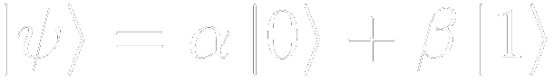
Qubits
The building block of quantum computation.
|0} and |1} eigenstates.
Quantum Mechanical wave functions need to be normalised.
Agnibho Chattarji ● Fidel Elie ● Ewan Morrison ● Alasdair Reid ● Jake Smith
Notes:
To begin to understand Quantum Computing it is important to understand what a qubit is, as this is the building block upon which all else is built. A qubit is analogous to a bit in classical computational science, but with a key set of differences. A classical bit can be either 0 or 1, whereas in true quantum mechanical fashion, a qubit collapses to either its ket0 or ket1 state when it is ‘observed’.
A qubit is a two-state quantum system, existing as a 2-component complex vector Psi. Traditionally this system's eigenstates are denoted as being ket0 and ket1, and the qubit is a linear superposition of the product of each of these states with the relevant amplitude, denoted by alpha and beta in equation.
In the realm of quantum computation, a qubit is a wavefunction. To ensure normalisation, a requirement for any quantum mechanical wavefunction, alpha squared + beta squared must always equal 1. Like the eigenstates, the amplitudes alpha and beta also exist in the complex domain. As a reminder of the physical meaning of these quantities: the probability of measuring the qubit's ket0 eigenstate is given by finding alpha squared. Here is a visualisation of a qubit which highlights the relation of the qubit to its eigenstates.

Slide 11
Quantum Register
Qubits are stored in a quantum register
Stores the tensor product of the individual qubits vector spaces.
The quantum register storing two qubits would be an 8-component complex vector C⁸
A simple example of two qubits.
Agnibho Chattarji ● Fidel Elie ● Ewan Morrison ● Alasdair Reid ● Jake Smith
Notes:
Qubits are stored in a quantum register, which is very different from classical data storage. While classical data can be stored in arrays and as a string of bits (`0101001'), the goal of a quantum register is to simultaneously store all the possible values which are spanned by the qubits it contains. A quantum register stores the tensor product of the individual qubits' vector spaces, and is a vector itself. For example, 3 qubits would be combined as such: C^2 x C^2 x C^2 = C^8, and the resultant quantum register would be an 8-component complex vector. Analogously to the possible combinations for binary representations of integers, the number of dimensions a quantum register containing n qubits is required to have is given as 2^n
A simple example is useful to show exactly what a quantum register containing 2 simple qubits would look like. Of course in practice the quantum registers which will be used will not usually be this simple, it is helpful as a way to picture exactly what is occurring.

Slide 12
Quantum Gates
Different to Classical Gates:
Have to be reversible (no AND or OR gates).
Typically represented by unitary matrices, a square matrix where a dimension is given as 2^{n}.
Agnibho Chattarji ● Fidel Elie ● Ewan Morrison ● Alasdair Reid ● Jake Smith
Notes:
Much like classical gates, in Quantum Computing there exists a basic set of quantum circuits which form the basis of more complex circuits. Examples of gates used in classical computing include AND, OR, and NOT gates which all act on either one or two classical bits. However, quantum gates have a key set of differences.
Firstly, they have to be reversible. Immediately it is apparent that this requirement has a large effect as it takes away the possibility of quantum analogues to the AND or OR gates as, by definition, the bits given to these gates are irredeemable. Another consequences is the fact the number of qubits which are outputted by the gate have to match the number which are given or inputted. Secondly, they are typically represented by unitary matrices, whose sizes are given as 2^n x 2^n where n is the number of qubits on which the matrices act, or a square matrix where a column (or row) is the length of the number of dimensions which would be present in a quantum register containing the qubits.
Qubits can also be represented as column vectors which is more appropriate in the discussion of gates, as it is in keeping with the unitary matrix multiplication representation of gates.

Slide 13
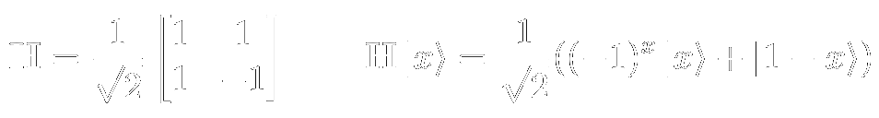
Hadamard (H) Gate
The Hadamard (H) Gate itself acts on a single qubit.
The Hadamard Gate acting on an eigenstate |x}.
Wide variety of applications.
Agnibho Chattarji ● Fidel Elie ● Ewan Morrison ● Alasdair Reid ● Jake Smith
Notes:
The Hadamard (H) gate is a simple gate which acts on a single qubit. In matrix form it is written as such. Below is shown how the Hadamard gate acts on an eigenstate, denoted as $\ket{x}$.
\begin{equation}\label{eqn:hadamard}
\qquad
\bold{H} = \frac{1}{\sqrt{2}} \begin{bmatrix}1&1\\1&-1 \end{bmatrix}
\qquad
\bold{H} \ket{x} = \frac{1}{\sqrt{2}}((-1)^{x}\ket{x}+\ket{1-x})
\end{equation}
This gate has a wide range of specific uses and is used in a wide variety of quantum algorithms including Grover's Algorithm and Shor's Algorithm. It is used in Grover's Algorithm when the quantum register is initialised and multiple times per iteration, namely after the oracle operator has been applied, and then again after the Grover operator has been applied \autocite{QCfromGroundUp}.\\

Slide 14
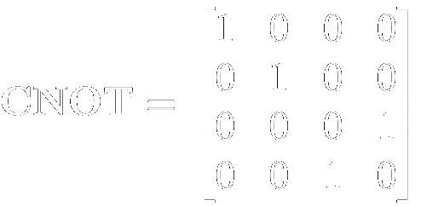
Controlled NOT (CNOT) Gate
Corresponds to a classical reversible XOR gate.
The gate in matrix form.
Similar operation to classical gate but entangles two qubits.
This gate is required for a physical computer of Grover’s Algorithm.
H, CNOT, phase shift gate -> Universal Set.
Agnibho Chattarji ● Fidel Elie ● Ewan Morrison ● Alasdair Reid ● Jake Smith
Notes:
A Controlled NOT (CNOT) gate is a quantum gate which is an integral part in the development of a quantum computer. The corresponding classical gate is a reversible XOR gate. It is reversible so that the reversibility condition of all quantum gates is satisfied. In matrix form the gate appears as this.
In some cases the gates operation appears to be very similar to its classical analogue but it is used to quantum mechanically entangle two qubits. It flips the target qubit if the control qubit is ket1 and does nothing if the control qubit is ket0. In order to implement Grover's Algorithm in a physical quantum computer, this kind of gate is required. The Hadamard and Controlled NOT gates together are powerful and a long with a phase shift gate, become a universal set of gates which enable all quantum algorithms to be performed.

Slide 15
Grover’s Algorithm
Quantum Algorithms
Agnibho Chattarji ● Fidel Elie ● Ewan Morrison ● Alasdair Reid ● Jake Smith

Slide 16
Grover’s Algorithm - Introduction
Can be applied to searching an unsorted database
Determines the single, unique input to a black box function, such that the function returns “True”
Evolves register to a state close to that which the oracle selects
Agnibho Chattarji ● Fidel Elie ● Ewan Morrison ● Alasdair Reid ● Jake Smith

Slide 17
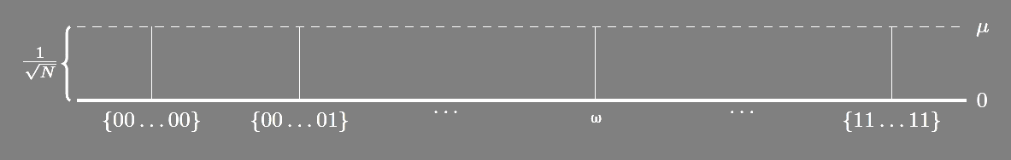
Grover’s Algorithm - Visualisation
1. Register is initialised into equal probability superposition of all basis states
Agnibho Chattarji ● Fidel Elie ● Ewan Morrison ● Alasdair Reid ● Jake Smith

Slide 18

Grover’s Algorithm - Visualisation
2. Apply Oracle operator to the register, inverting the amplitude of the desired state
Agnibho Chattarji ● Fidel Elie ● Ewan Morrison ● Alasdair Reid ● Jake Smith

Slide 19

Grover’s Algorithm - Visualisation
3. Invert amplitudes of all basis states around the mean
Agnibho Chattarji ● Fidel Elie ● Ewan Morrison ● Alasdair Reid ● Jake Smith

Slide 20
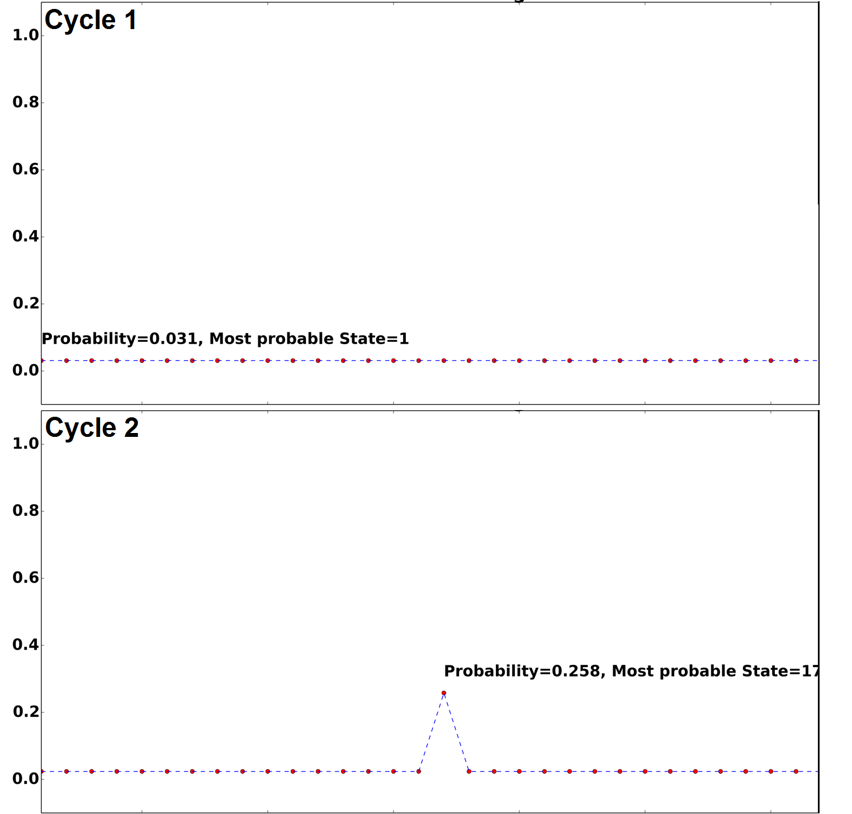
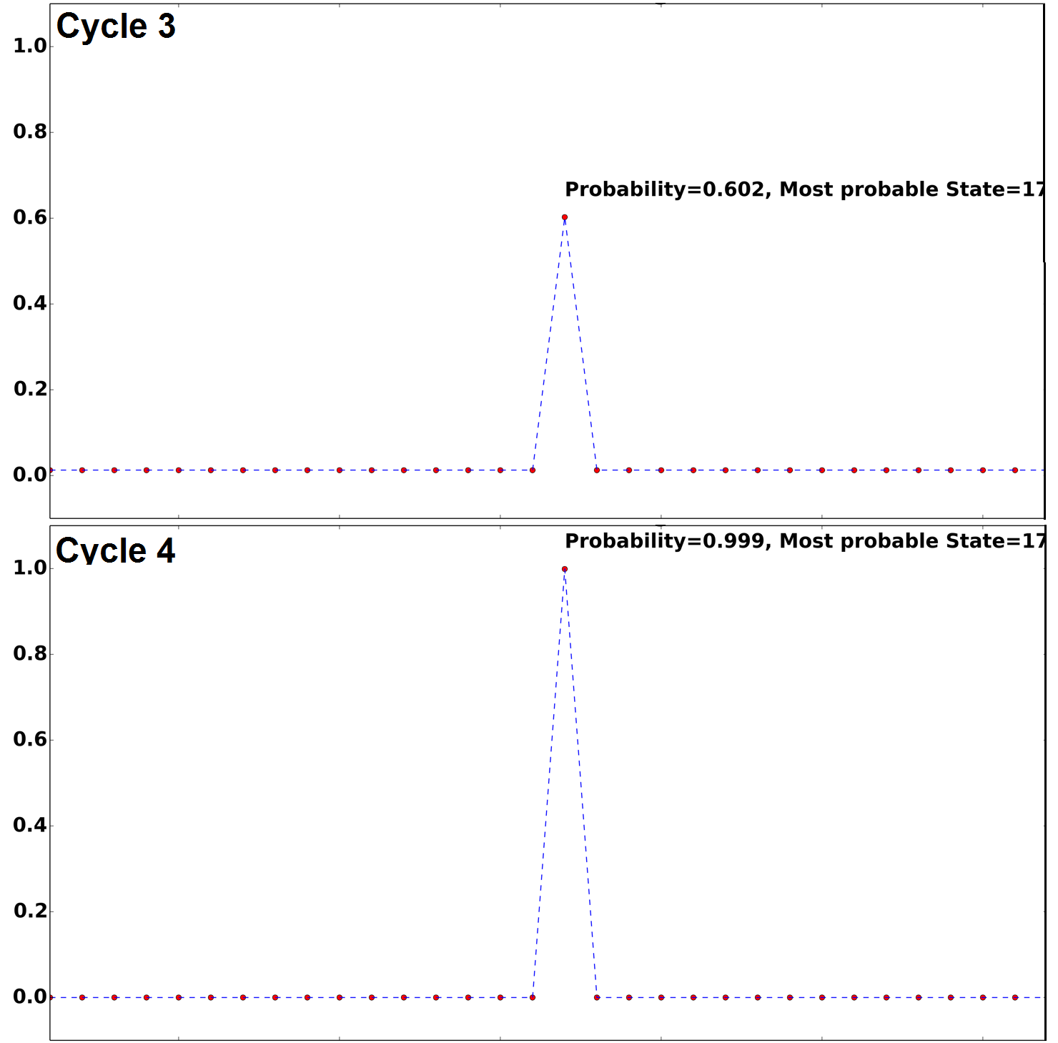
Grover’s Algorithm - Visualisation
4. Rinse and Repeat!
Probability of observation
Agnibho Chattarji ● Fidel Elie ● Ewan Morrison ● Alasdair Reid ● Jake Smith

Slide 21




Grover’s Algorithm - Mathematical Formulation
Agnibho Chattarji ● Fidel Elie ● Ewan Morrison ● Alasdair Reid ● Jake Smith

Slide 22

Grover’s Algorithm - Have we Gone too Far?!
Applying Grover’s operator when the desired state amplitude is large will reduce the amplitude
There must exist an optimum number of iterations
Agnibho Chattarji ● Fidel Elie ● Ewan Morrison ● Alasdair Reid ● Jake Smith

Slide 23
Simulation of Quantum Computer
Python 2.7
Class quantum register
Implement Grover’s algorithm
Broken up into different modules
Agnibho Chattarji ● Fidel Elie ● Ewan Morrison ● Alasdair Reid ● Jake Smith

Slide 24
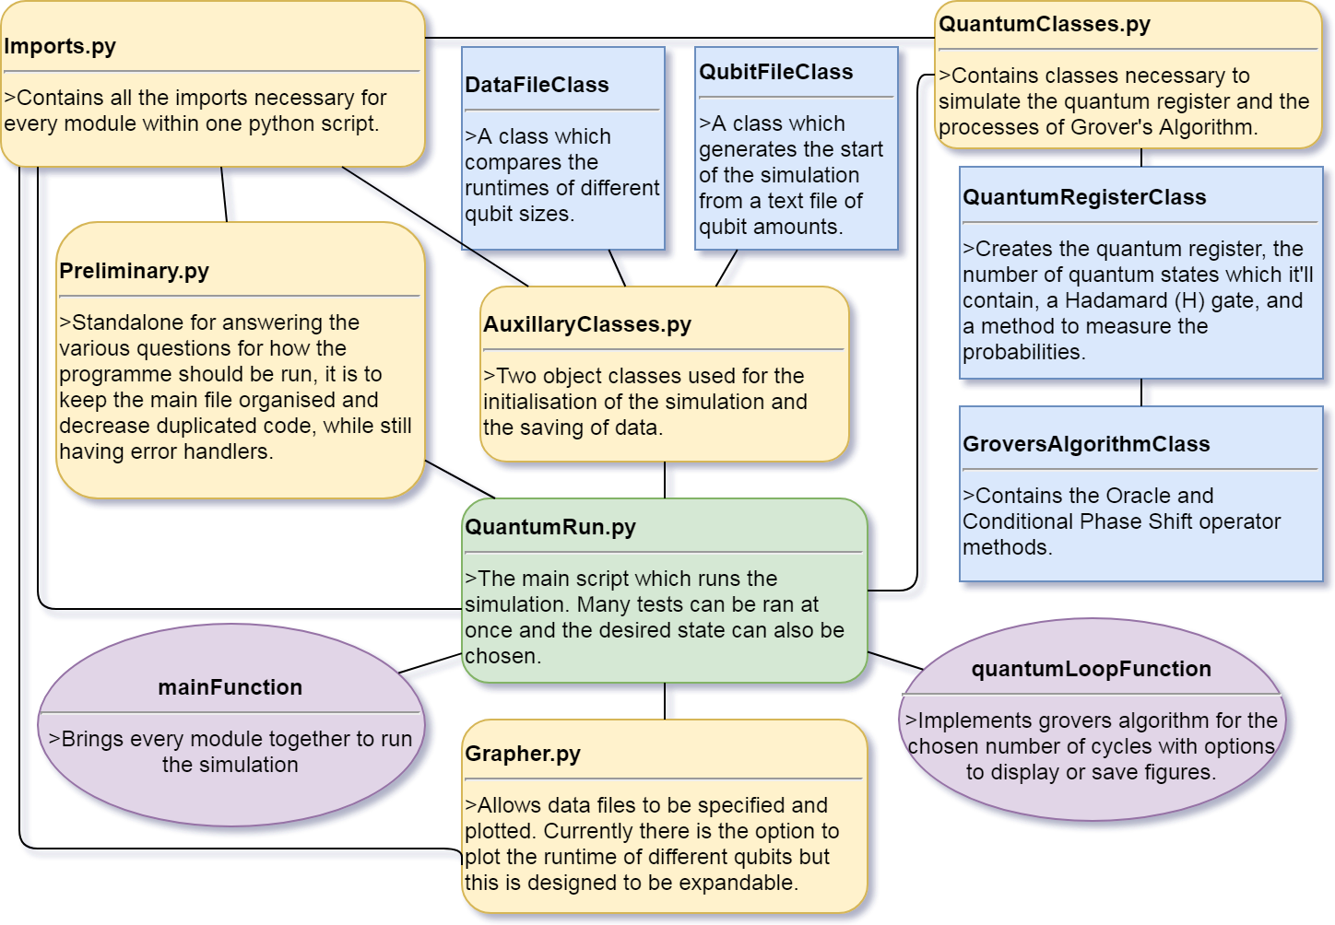

Slide 25

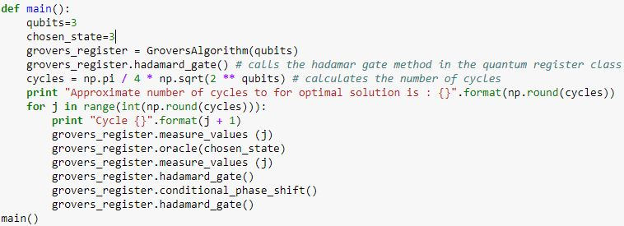
Grover’s Algorithm

Slide 26
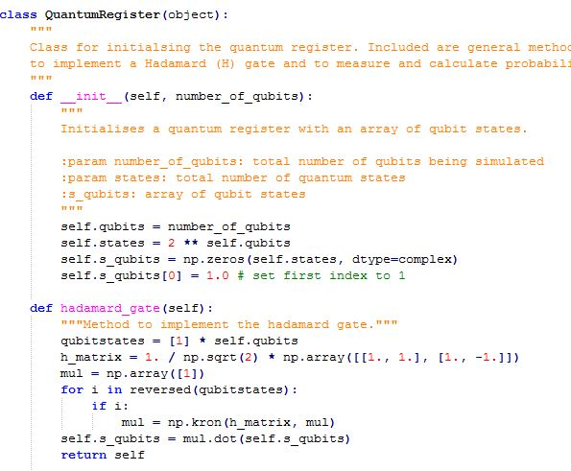
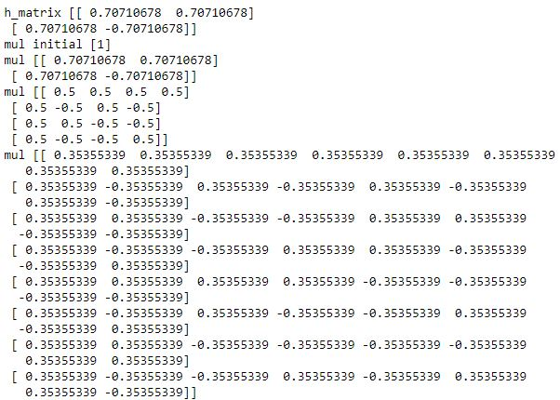
Quantum Register and Hadamard Gate

Slide 27
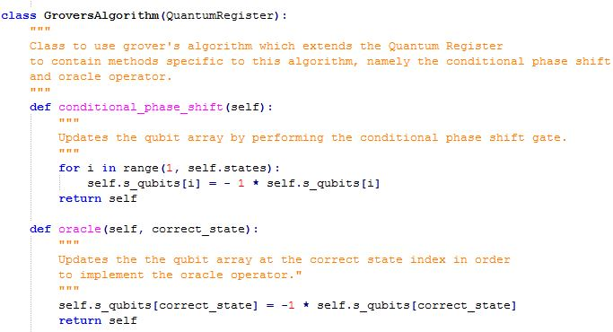
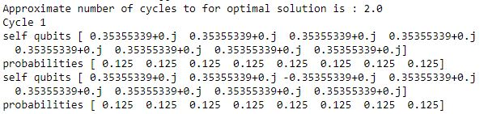
Conditional Phase Shift and Oracle

Slide 28
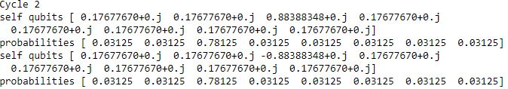
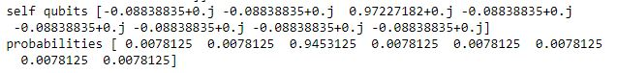
Conditional Phase Shift and Oracle

Slide 30
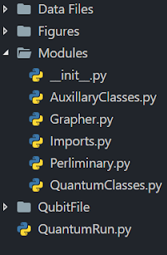
Programme Structures
Our Design Philosophy started with the file structure of the programme.
This was to keep the workspace organized and to minimise confusion for a third party.
Agnibho Chattarji ● Fidel Elie ● Ewan Morrison ● Alasdair Reid ● Jake Smith

Slide 31

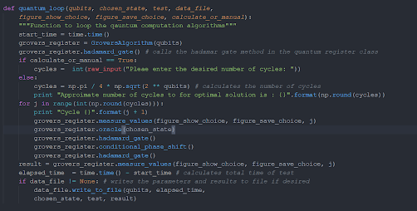
Where it all runs
Luckily ours did, and This file is responsible for calling everything else in the programme.
Agnibho Chattarji ● Fidel Elie ● Ewan Morrison ● Alasdair Reid ● Jake Smith

Slide 32
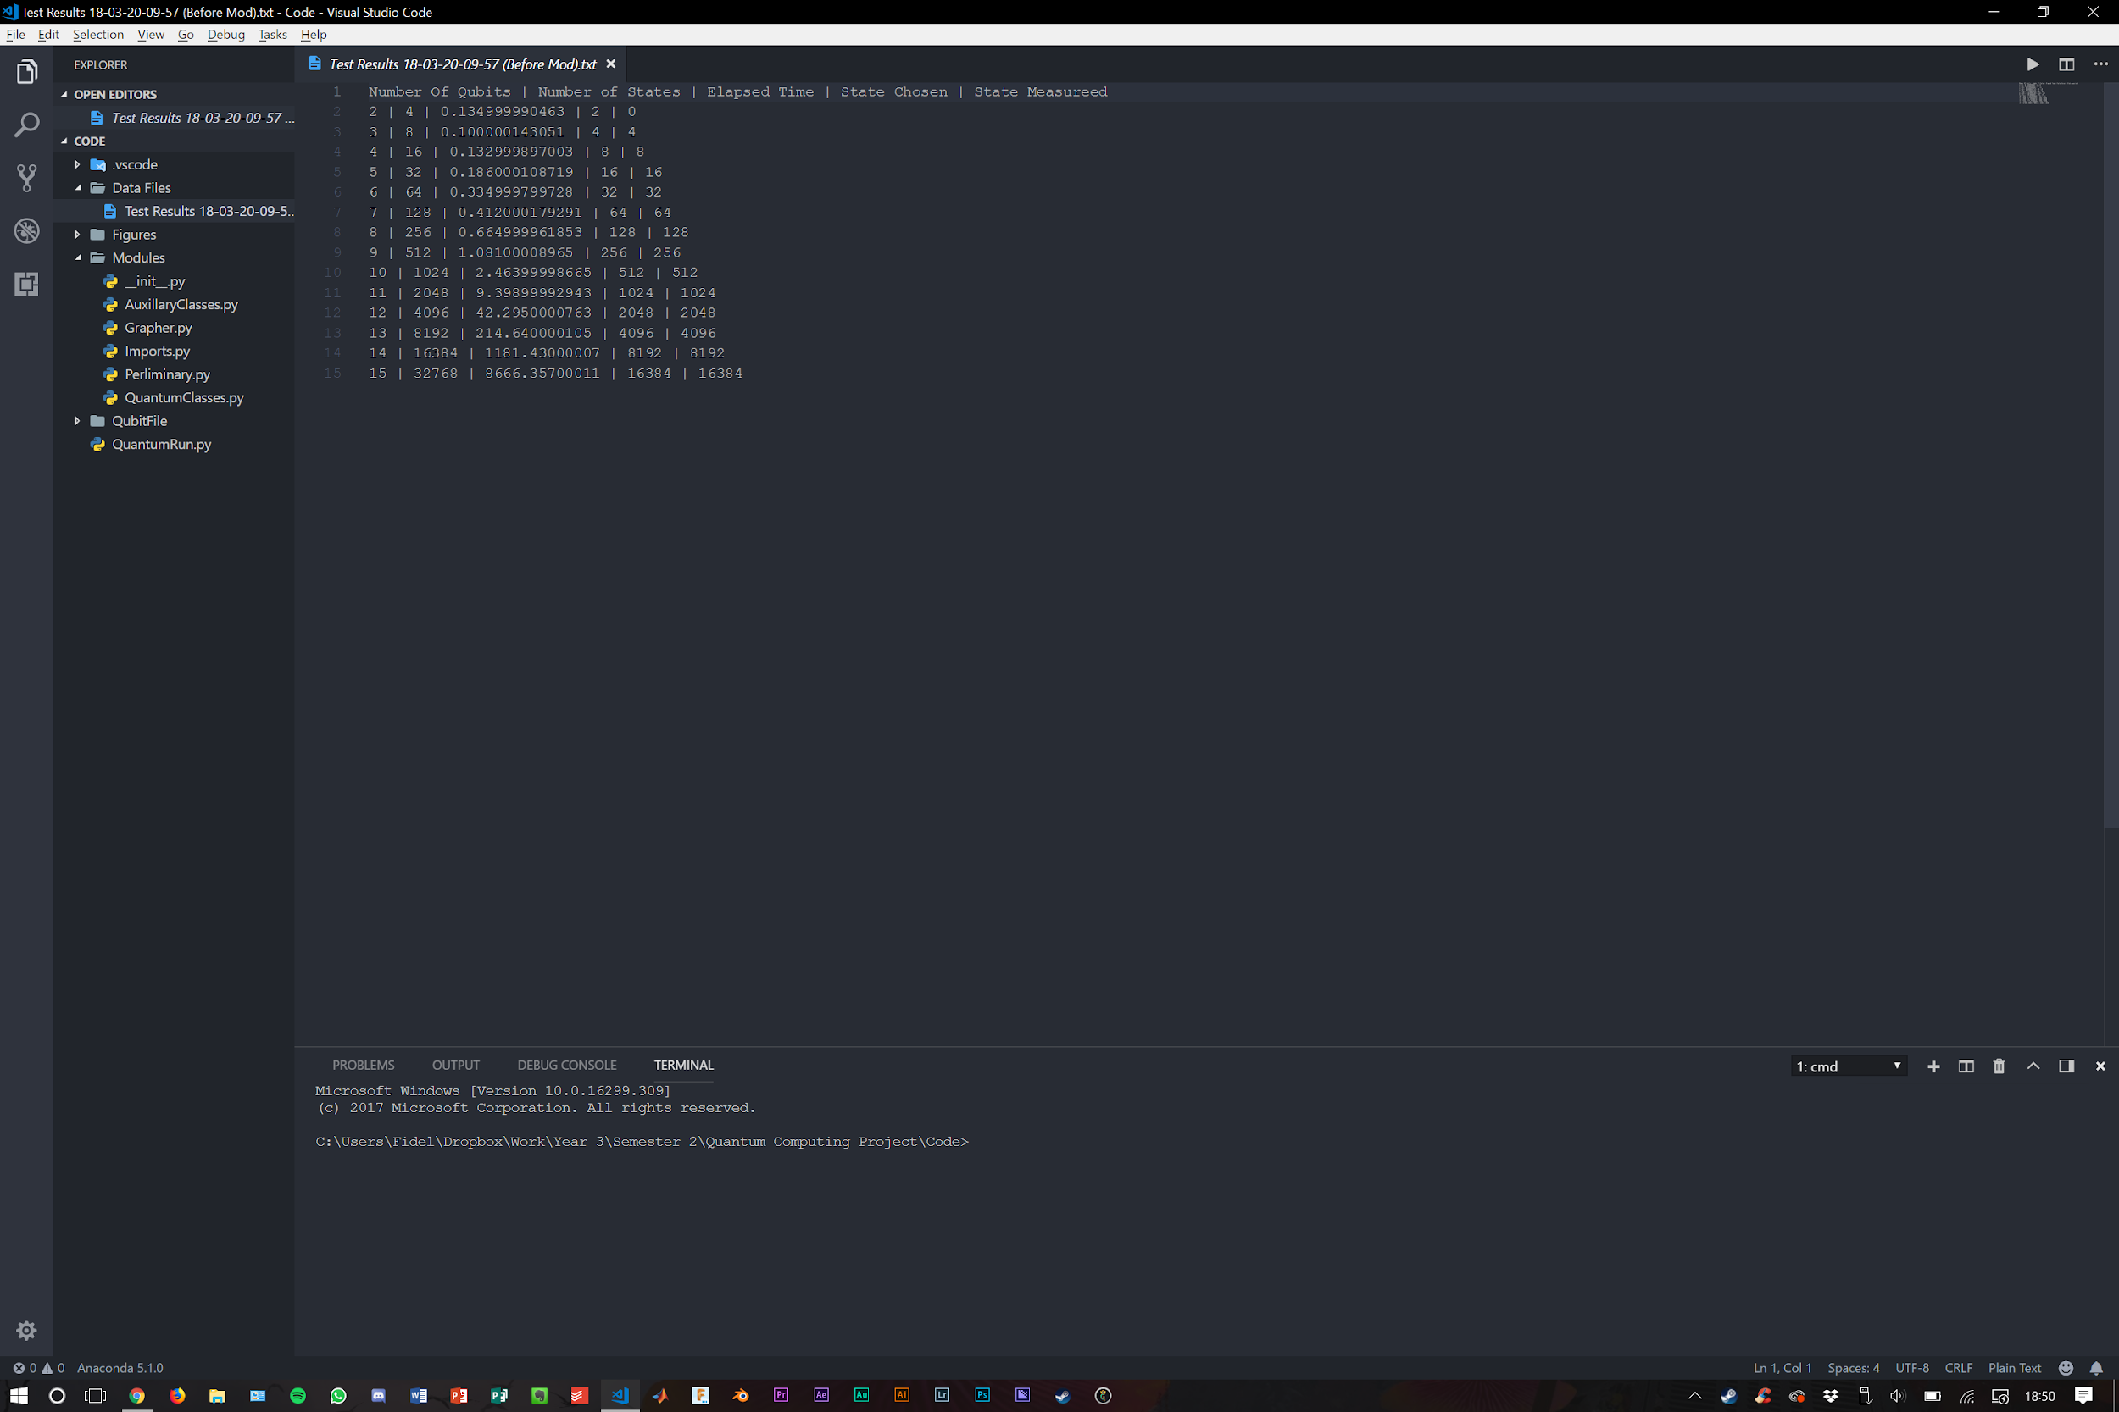
Auxiliary Files
These are the two files AuxilliaryClasses.py and Grapher.py that are used to perform extra functions.
These include creating structured test result files as well as manipulating them.
Agnibho Chattarji ● Fidel Elie ● Ewan Morrison ● Alasdair Reid ● Jake Smith

Slide 33

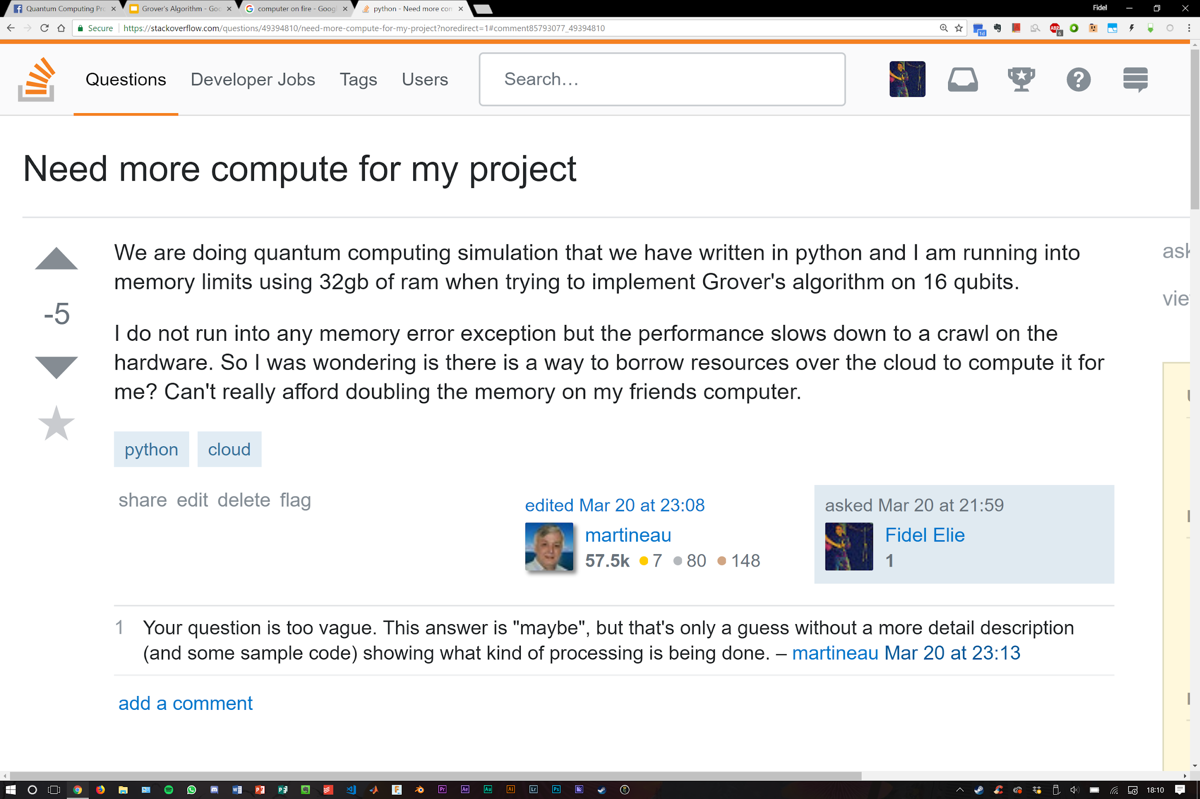
The Campaign for 16 Qubits
Hard limits were reached when Grover’s Algorithm was implemented on a 16 qubit simulation.
32Gb of RAM was still not enough to simulate this number in a timely manner.
Agnibho Chattarji ● Fidel Elie ● Ewan Morrison ● Alasdair Reid ● Jake Smith

Slide 34
Grover’s Algorithm Results
Quantum Simulation

Slide 35
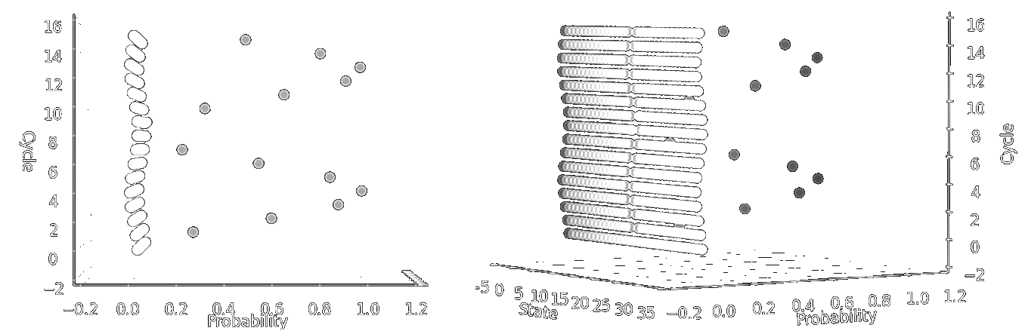
5-qubit Simulation - Excessive Cycles
Agnibho Chattarji ● Fidel Elie ● Ewan Morrison ● Alasdair Reid ● Jake Smith
Notes:
The three-dimensional plots in Figure show how a 5 quibt system progresses when run for more than optimal number of cycles. For each plot, the x axis shows the probability of measurement of any given state, the y axis shows the cycle number, and the z axis shows the state number. As described in Section the optimal number of cycles can be approximated using equation.

Slide 36

5-qubit Simulation - Excessive Cycles
Agnibho Chattarji ● Fidel Elie ● Ewan Morrison ● Alasdair Reid ● Jake Smith
Notes:
As can be seen from the plots, the probability of observing the desired state increases as the cycle number approaches the optimum number, before decreasing again. This is a result of the amplitude of the desired state becoming so large, that when inverted, the mean amplitude across all states becomes negative, resulting in the reduction of the amplitude of desired state after performing inversion around the mean. When run for yet more cycles the amplitude of the desired state follows a wave-like pattern, decreasing after the optimum number of cycles until the register returns to a state very similar to the initial superposition, before once again increasing towards a maximum. This behaviour is to be expected with Grover's algorithm, and once again is evidence for a successful implementation.

Slide 37
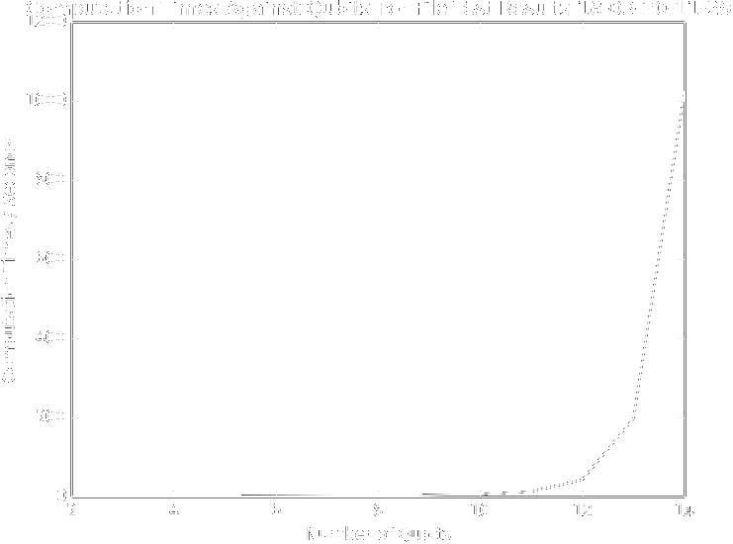
Agnibho Chattarji ● Fidel Elie ● Ewan Morrison ● Alasdair Reid ● Jake Smith
Notes:
This diagram shows a plot of the computational time in seconds against the number of qubits being tested. As can be seen for qubit values up to 10 the computation times are small. For qubit values greater than 10, the execution times start to jump at an increasing fast rate, this exponential growth in the time taken is to be expected. With the number of states increasing to the power of n, each cycle becomes more and more computationally demanding, and a greater number of cycles is required to find the desired state with optimum accuracy. Included on the graph are the qubits ranging from 2 to 14. While the code does have the potential to run 15 qubits and higher, it becomes so computationally demanding that most consumer computers are unable to complete the algorithm. 15 qubits was successfully performed on a computer that managed to complete the cycles in 8666 seconds, however for the purpose of demonstrating results this value has not been included. This exponential growth in execution time is a consequence of modelling the algorithm using classical methods. By making use of quantum parallelism, an ideal quantum computer would see no increase in execution time for a single cycle with increasing numbers of qubits, with the only increase in execution time of the algorithm being as a result of having to perform more cycles for larger registers.

Slide 38
Real Quantum Computers and Grover’s Algorithm
Applied Quantum Computing
Agnibho Chattarji ● Fidel Elie ● Ewan Morrison ● Alasdair Reid ● Jake Smith

Slide 39
Physical 3-qubit Grover’s Algorithm
Grover’s algorithm can be implemented on a classical computer relatively easily but is a much greater challenge for a quantum computer.
In 2017, Grover’s Algorithm was implemented using a three qubit system.
Agnibho Chattarji ● Fidel Elie ● Ewan Morrison ● Alasdair Reid ● Jake Smith
Notes:
Whilst Grover's algorithm can be modelled on a classical computer relatively simply, implementing a working quantum computer to run the algorithm is an far more difficult task. In 2017, a three qubit Grover's search was implemented using a programmable quantum computer, using trapped atomic ions. This was the first example of Grover's algorithm running with more than 2 qubits on scalable quantum computing technology.

Slide 40
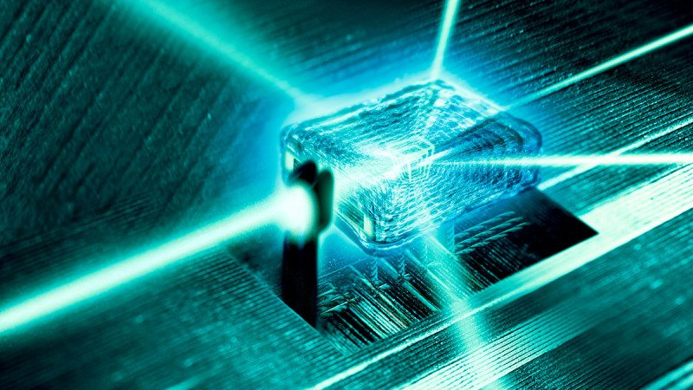
Laser
Computing
Agnibho Chattarji ● Fidel Elie ● Ewan Morrison ● Alasdair Reid ● Jake Smith
Notes:
The computer was implemented by trapping laser cooled positive Ytterbium ions in a magnetic field to act as qubits, which were manipulated by pulsed lasers operating as quantum gates. Recently there has been a preference to use designs which don’t use lasers to perform as gate operations as these are difficult to control and a very sensitive to noise. This will be discussed in the next section.

Slide 41
3-qubit Computer Results
The comparison between quantum and classical was made after one iteration. Quantum: 78.125% Classical: 25.000% - Choosing ¼ states.
Searching for 1 of 2 desired states had a 100% success rate using quantum computation methods and 50% classically.
Agnibho Chattarji ● Fidel Elie ● Ewan Morrison ● Alasdair Reid ● Jake Smith
Notes:
The quantum algorithm was compared to an equivalent classical algorithm by running both algorithms for a single iteration, and comparing the probability of determining a correct solution for each. A classical three bit search for a single desired value can only ever attain a probability of 25% after one iteration, as the best a classical algorithm can achieve is to check one entry to see if it is the desired value, and if not, guess another value at random. However, Grover's algorithm was found to identify the desired state with a probability of 78.125% after a single iteration. Similarly, when searching for one of two desired states, the classical algorithm achieved an accuracy of just 46.4%, whilst Grover's algorithm found one of the desired states after one iteration with a probability of 100%.
Whilst a Grover's search of a three qubit system offers little practical application, the improvements over classical algorithms are clearly demonstrated, and as such systems are scaled to larger and larger numbers of qubits, these improvements will become significant in the solution of real-world problems. This experiment served as a proof of concept.

Slide 42
The Future of Quantum Computation
Applied Quantum Computing
Agnibho Chattarji ● Fidel Elie ● Ewan Morrison ● Alasdair Reid ● Jake Smith

Slide 43
A Scalable Quantum Computer
The prospect of a large-scale quantum computer has been an exciting one for quite some time.
Last year a group predominantly from the University of Surrey proposed a blueprint for a fully modular large-scale machine capable of reaching nearly arbitrary large computational processing powers
Agnibho Chattarji ● Fidel Elie ● Ewan Morrison ● Alasdair Reid ● Jake Smith
Notes:
The prospect of real-life quantum computation has been recognised as being highly advantageous to many research fields, and perhaps to society as a whole, but as of yet the construction of a large scale quantum computer has not been made feasible. This has been an ongoing area of research since as early as the 1980s with numerous designs for physical machines.
This section will look at one of the most recent, prominent designs for a quantum computer based around microwave trapped ions. This was published only last year and has already been gaining traction in the field with some hailing it as the “first viable blueprint of a quantum computer”. The basic premise of this blueprint which separates it from previous designs is that it is fully scalable, and consists of many individual components which can be easily connected, thus solving many of the problems previously faced by existing quantum computer designs. These individual components are quite complex in design but are simple in principle.

Slide 44
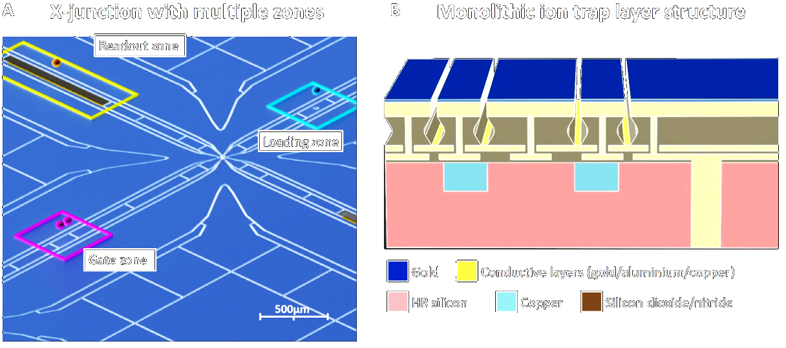
X-Junction (1)
B. Lekitsch et al. (2017)
Agnibho Chattarji ● Fidel Elie ● Ewan Morrison ● Alasdair Reid ● Jake Smith
Notes:
The components, or modules, are micro-fabricated chips which contain atomic ions trapped by microwaves in many junctions called X-Junctions, and are the unit cells of the quantum computer. These X-Junctions are comprised of three zones, one for loading and trapping an ion, another zone where microwave-based gate operations can be performed on a set of ions and a readout zone where an ion's state can be read using a global laser. Ions can be transported from the loading zone to the gate zone using ion shuttling operations, and then magnetic fields can be used to address them individually, as well as entangle them with the aid of electric fields. State detection is also made possible by then shuttling an ion to the readout zone. The main benefit of only using a global laser for the process of measuring states is that the laser requirements for measurement are far less stringent than those imposed on lasers used to realise quantum gates.
Atomic ions have long been recognised as suitable candidates for quantum computers \autocite{TrappedIon} as they are a quantum system which is often not only stable but also well defined. They also allow logical gate operations to be performed through utilisation of the strong Coulombic interactions between ions to couple different qubits. Some argue that trapped ions are the best candidate for the physical realisation of qubits on a large scale.

Slide 45

X-Junction (2)
B. Lekitsch et al. (2017)
Agnibho Chattarji ● Fidel Elie ● Ewan Morrison ● Alasdair Reid ● Jake Smith
Notes:
Atomic ions have long been recognised as suitable candidates for quantum computers as they are a quantum system which is often not only stable but also well defined. They also allow logical gate operations to be performed through utilisation of the strong Coulombic interactions between ions to couple different qubits. Some argue that trapped ions are the best candidate for the physical realisation of qubits on a large scale.

Slide 46
Atomic Ions
A separate research group has identified ⁴³Ca⁺ ions as suitable candidates.
Easily discernible hyperfine states, and can be trapped using radiofrequency electric fields. This solves a multitude of common noise problems.
Agnibho Chattarji ● Fidel Elie ● Ewan Morrison ● Alasdair Reid ● Jake Smith
Notes:
43^Ca+ is an atomic ion which exists as two hyperfine states, and can be trapped using radiofrequency electric fields. With a modestly sized applied magnetic field, the energy gap between the two states is sufficiently large, increasing the discernibility of the two states. This `easy discernibility' is also known as being high-fidelity, an important feature as this overcomes problems associated with working in noisy environments where similar qubit states could otherwise be confused.

Slide 47
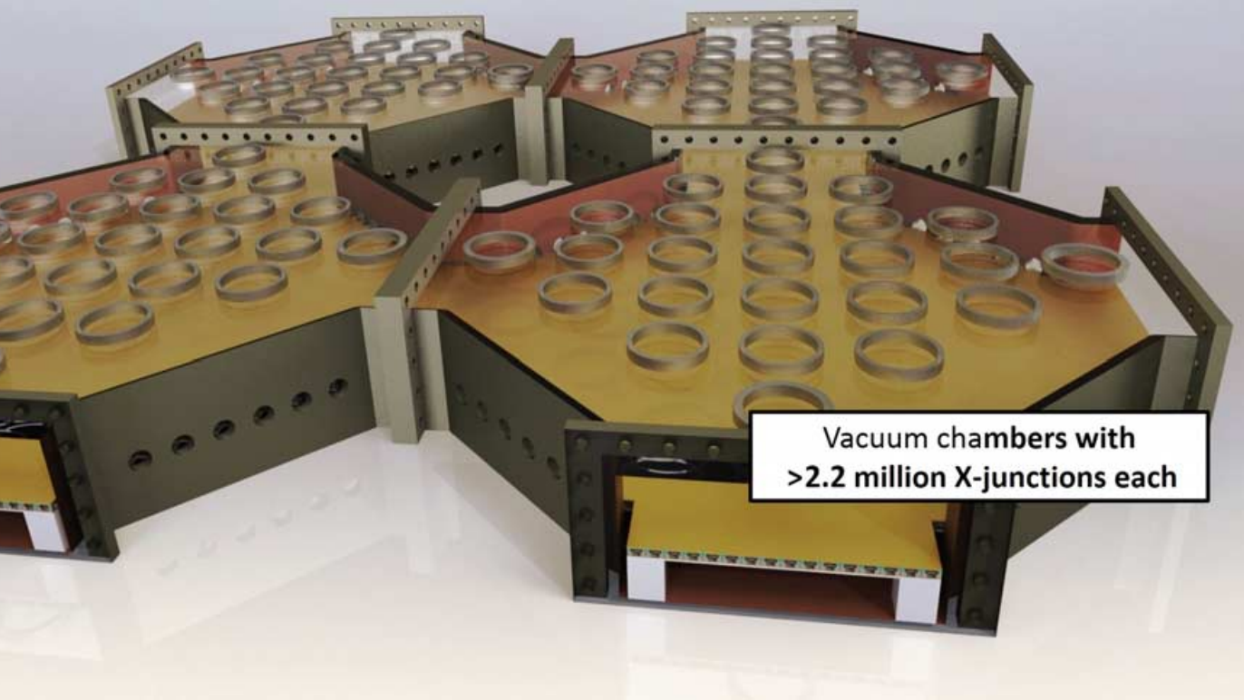
Design Scalability
Design
Scalability
Agnibho Chattarji ● Fidel Elie ● Ewan Morrison ● Alasdair Reid ● Jake Smith
Notes:
The team specifically proposed a design where 2.2 million X-Junctions could exist within vacuum chambers, as well as describing mechanisms by which these chambers could connect, thus scaling the possible system sizes to be even larger. Finally, they performed vigorous theoretical testing on a computational model of the blueprint and found it could withstand a realistic amount of misalignment of internal modules.

Slide 48
Conclusion
Agnibho Chattarji ● Fidel Elie ● Ewan Morrison ● Alasdair Reid ● Jake Smith
Notes:
The two main aims of this paper were firstly to introduce the concept of quantum computation; and to present a simulation of a quantum computer running Grover's algorithm and the results that this simulator obtained. Quantum computers were introduced by first discussing classical computer construction and data representation using transistors. The motivation for building quantum computers was introduced, presenting Moore's law of transistor density and the fact that transistor density must approach a limit when transistors reach a quantum scale. The introduction also briefly discussed the mechanisms by which quantum computers would use qubits and, as well as highlighting some of the advantages quantum computation offers over its classical counterpart, the paper presented an example of a 53 qubit quantum simulator that has been built and explained the physics behind how it works.
This rather surface level introduction was then followed with a more in depth discussion of the back ground science. This started with a discussion of qubits in which Dirac notation was used to introduce the mathematics behind the concept. Following this, quantum registers were introduced, discussed and an example of the mathematics used to combine qubits into a register was presented. Using the concepts of qubits and quantum registers Grover's algorithm was explained to the reader, and formulated mathematically. One key function of this section was to present the expected results of Grover's algorithm so that the results of our own quantum simulator could be compared to the theoretical expectations. Following this was a discussion of a more complex quantum algorithm, Shor's algorithm. Shor's algorithm is a method of finding two unknown prime factors of a third known number, a method that classical computers fall very short in performing \autocite{moreShor}. This section of the paper also included an introduction to quantum gates, discussing how they differ from classic computational gates as well as presenting an example known as the Hadamard gate. The Hadamard gate as shown in equation~\ref{eqn:hadamard} has a wide range of uses including Grover's algorithm.
The second key aim of the paper was to present a simulation of Grover's algorithm created in Python 2.7. Firstly, to do this, a short programme overview of the code's user interface is presented along with a flow chart explaining the options a user has to choose from. Following this there is an in depth discussion of the program design methods, starts with a discussion of the various modules that were set up to create the simulation. These modules include: an import module, that imports all the required code packages; an auxiliary class module that sets up the user interface questions; as well as a preliminary questions module that uses the user's answers to choose what implementations the code will perform. The quantum classes module is then explained: this class contains the key implementations of Grover's algorithm including the Hadamard gate. As well as explaining the main function of the code and the graphing module the paper also presents a design diagram to show how the different modules and classes work together.
Following this the paper presents the results of the Grover's algorithm simulator. The results start by showing all four cycles of a 5 qubit system and discussing different features of the graphs, in relation to how they show that the code successfully implemented the algorithm. The results then use a 3D plot to visually represent what happens when a system of qubits is run past its optimal cycle number. These plots demonstrate another key feature of Grover's that after the optimal number of iterations has been reached the probability of the desired state reduces again. Also presented in the results are iterations from a 14 qubit system to demonstrate some of the potential the simulator created has. After this there is a plot that shows how long, in seconds, each of the different qubit systems take to reach their optimal iteration. Having such a successful implementation of Grover's algorithm the paper concludes that quantum computers have great potential to be the future of computational technology, and along side this the paper finishes by presenting the potential future of quantum computers.

